Slide 1

Who Pass the Bar?
Final Project of Introduction to Data Mining
December 12, 2022
Team 8: Brunda Mariswamy, HaeLee Kim, Mahikshit Kurapati

Slide 2

SMART QUESTIONS
What contributions affect the LSAT score significantly?
(Models used: LR, Decision Regression Tree, PCR)
What contributions significantly affect clearing the bar exam?
(Models used: Logit Regression, KNN)

Slide 3
About the Data Set
Source:
The dataset was originally collected for a study called 'LSAC National Longitudinal Bar Passage Study.'
Found in Kaggle https://www.kaggle.com/datasets/danofer/law-school-admissions-bar-passage
Details:
22407 observations of 39 variables

Slide 4
To Prepare EDA
Dropped NAs
Dropped columns with duplicate information
Converted data types of variables: from categorical to numeric, from float to int
Filtered Data Set
21985 observations of 9 variables

Slide 5
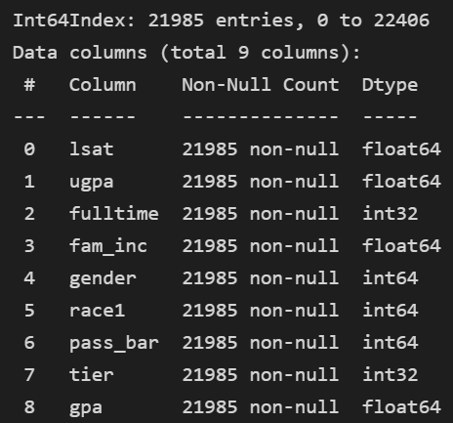
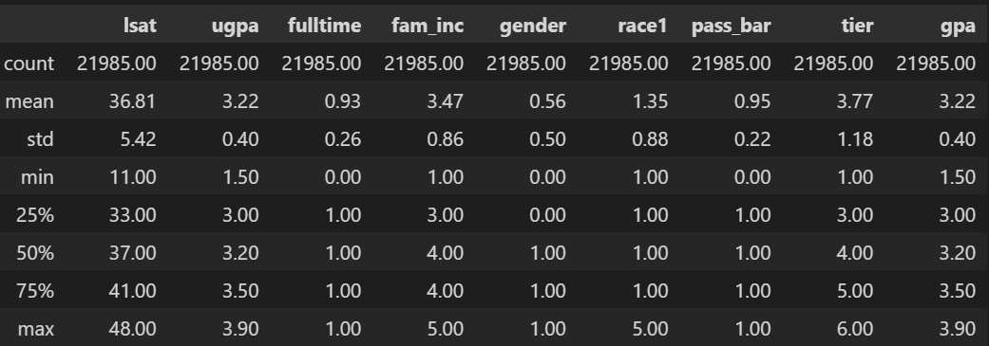
Summary of the Data Set
Dependent Variables: LSAT score, Bar Pass (0: Failed, 1: Passed)
Independent Variables: Undergraduate GPA, Law School GPA, Full time, Family Income, Gender, Race, Law School Tier

Slide 6
Models & Graphs
Models Used
EDA: ANOVA
Question 1: Linear Regression, Decision Tree Regression, PCA
Question 2: Logit Regression, KNN
Graphs Used
EDA: Histogram, Boxplot, Correlation Matrix, etc.

Slide 7

Exploratory Data Analysis

Slide 8
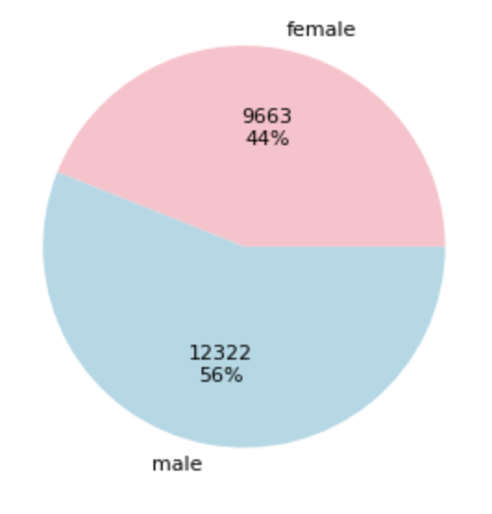
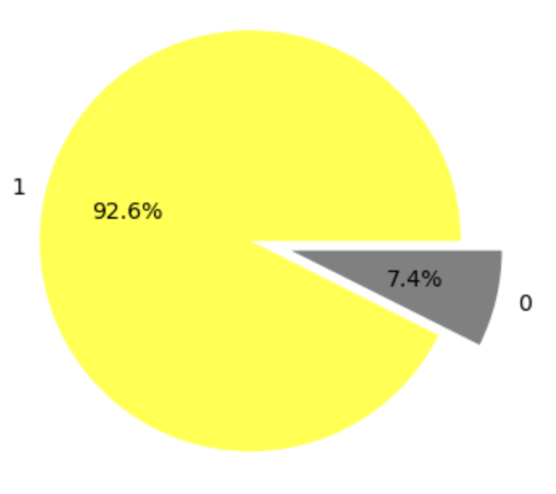
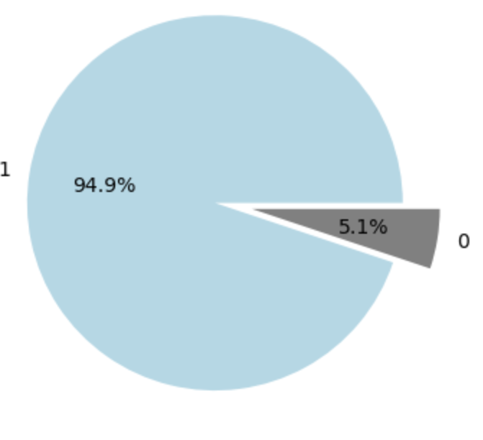
General Analysis of Data Set
92.6% percentage of students enrolled for Full Time course (1)
94.9% students passed the bar (1)
56% Male (1) and 44% Female (0) candidates appeared for bar exam

Slide 9
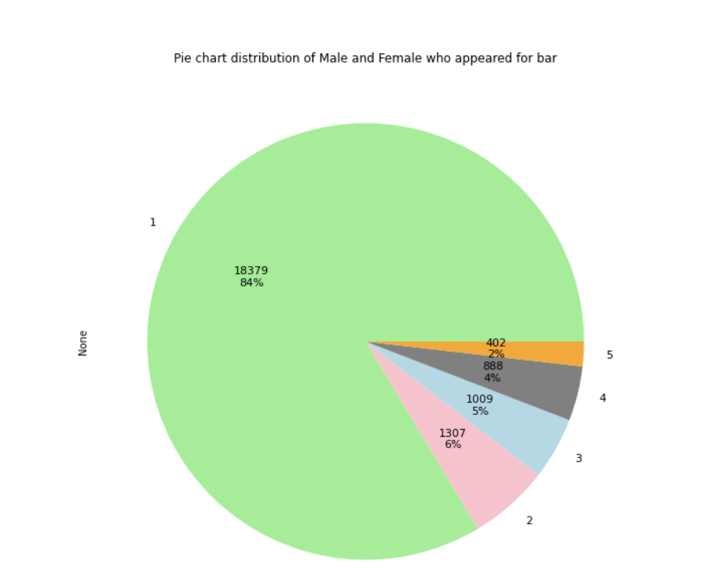
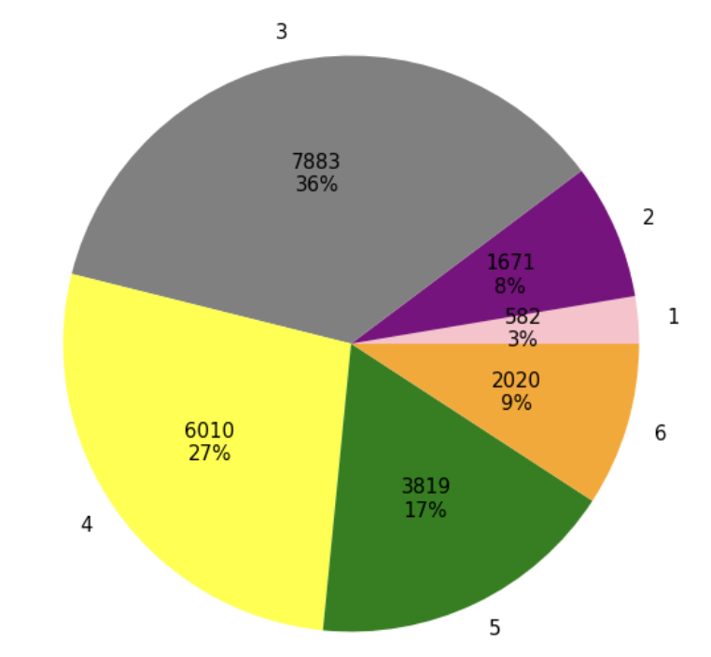
General Analysis of Data Set
Percentage of students enrolled for different school tiers from low (1) to high (6)
Percentage of students who belong to different races

Slide 10
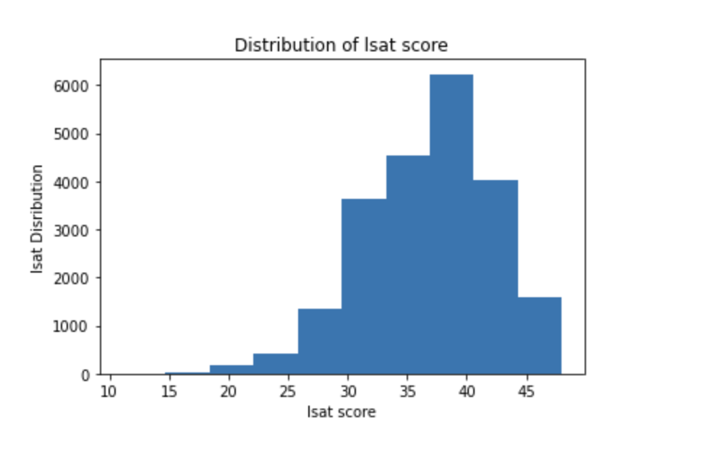
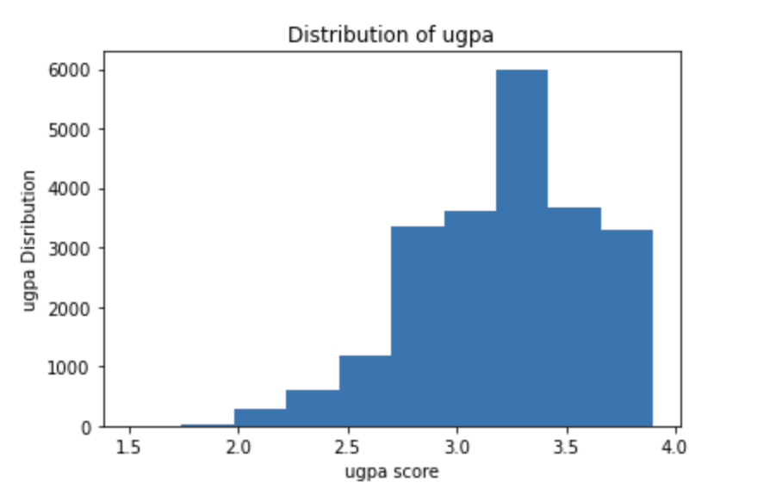
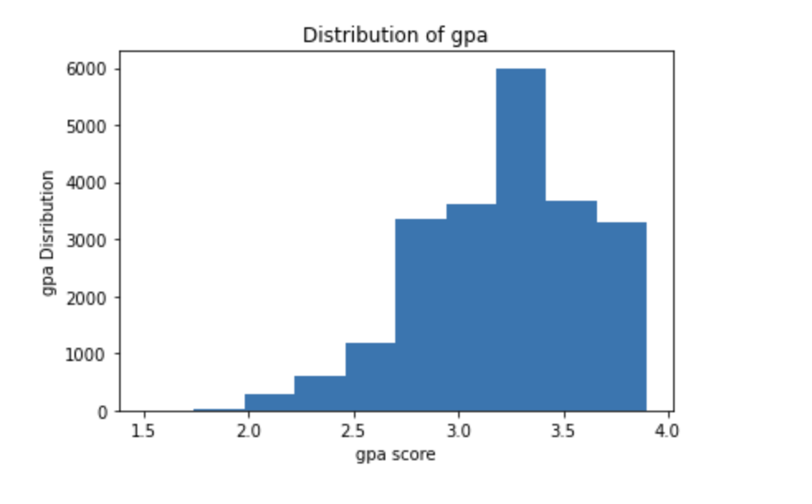
Normality Check for LSAT & GPAs
Notes:
Lsat avg=36.8
Ugpa avg=3.22
Gpa avg=3.22

Slide 11
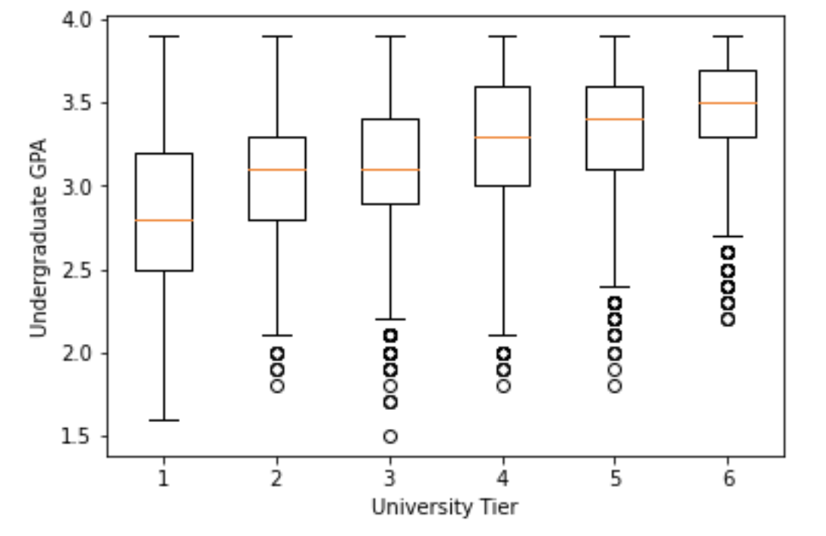
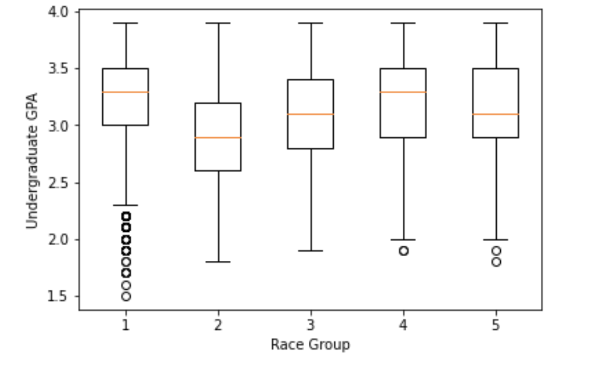
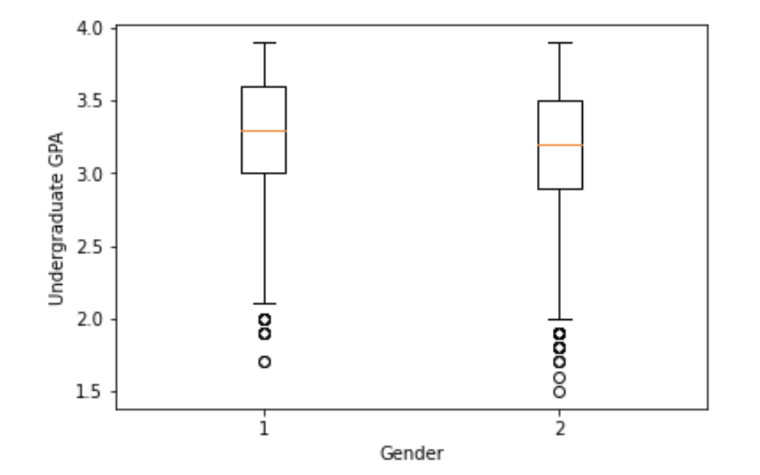
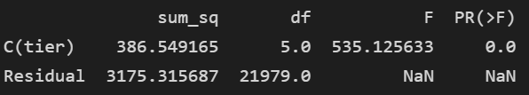
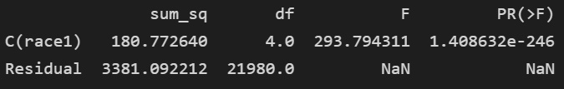
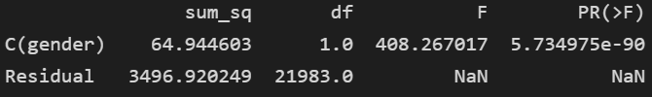
Boxplot & ANOVA for Undergraduate GPA
School Tier
Race
Gender

Slide 12
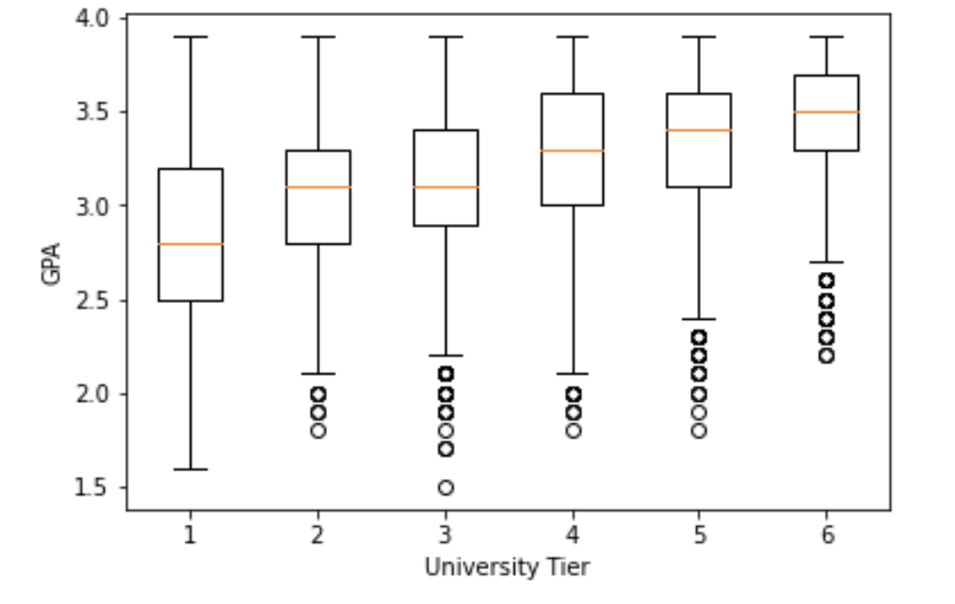
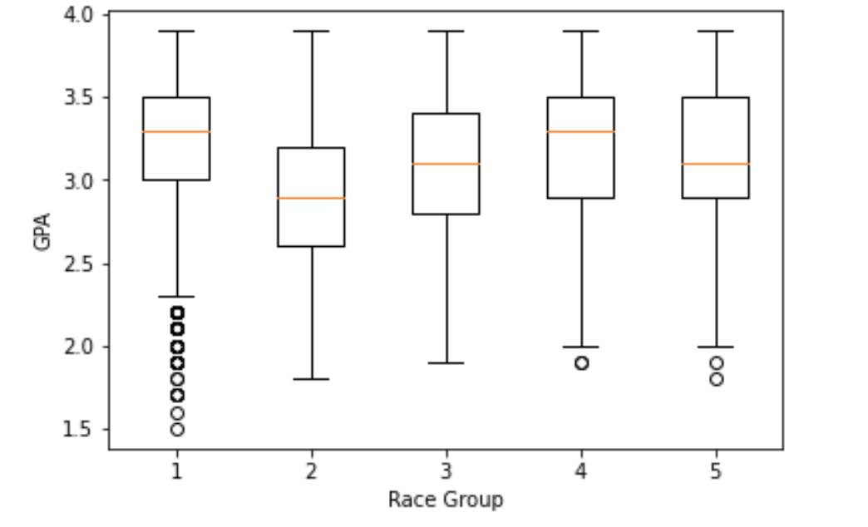
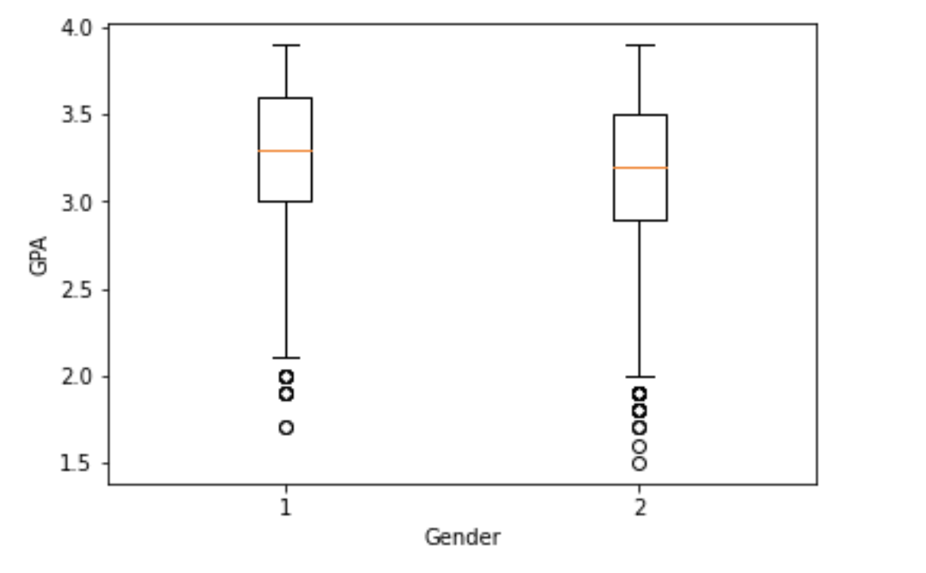
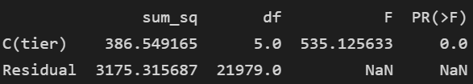

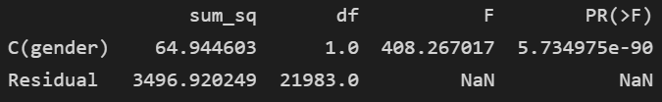
Boxplot & ANOVA for Law School GPA
School Tier
Race
Gender

Slide 13
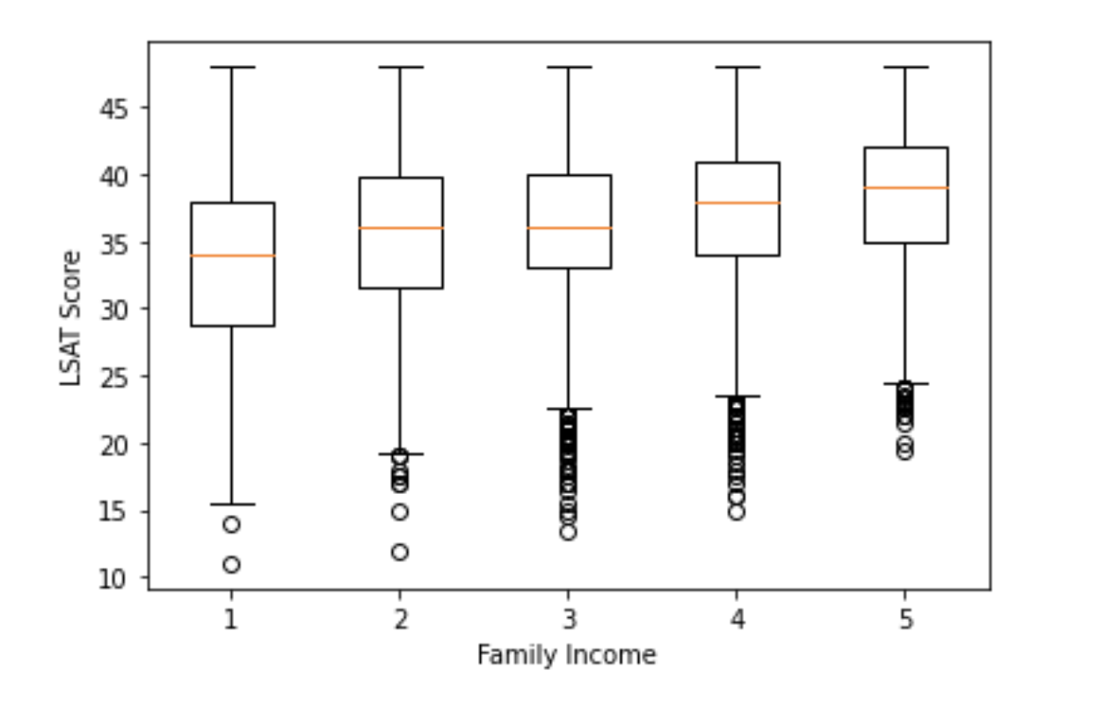
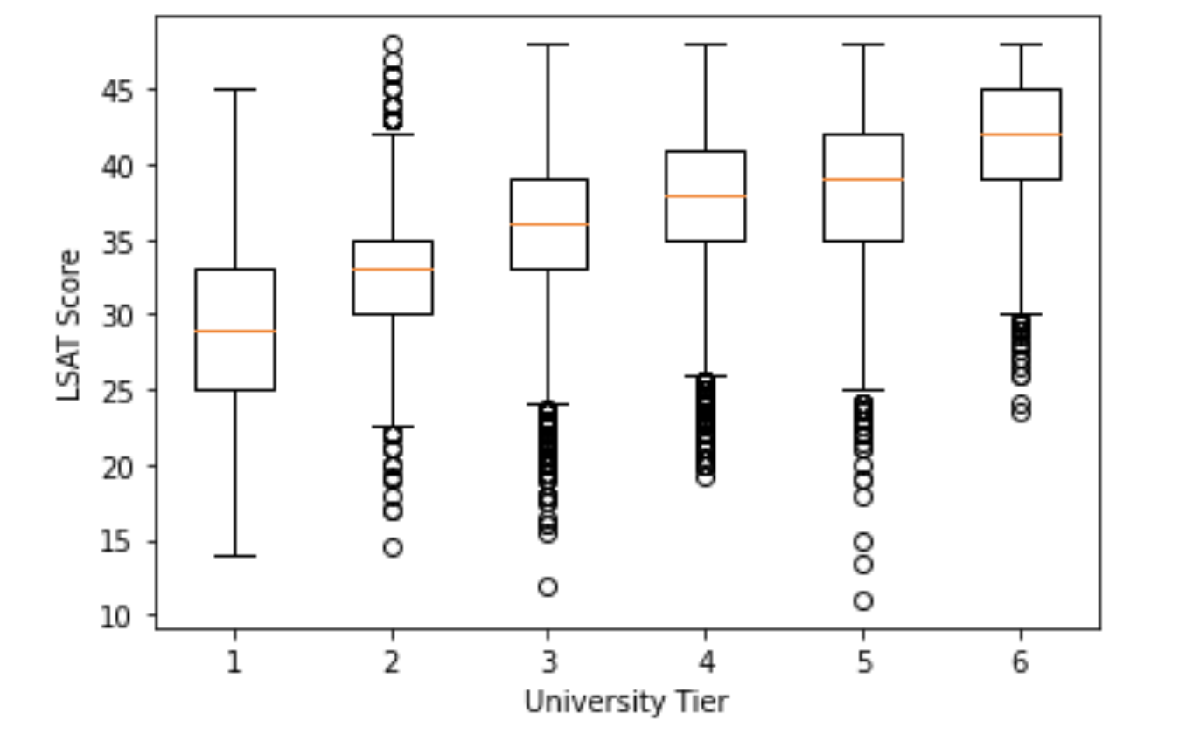
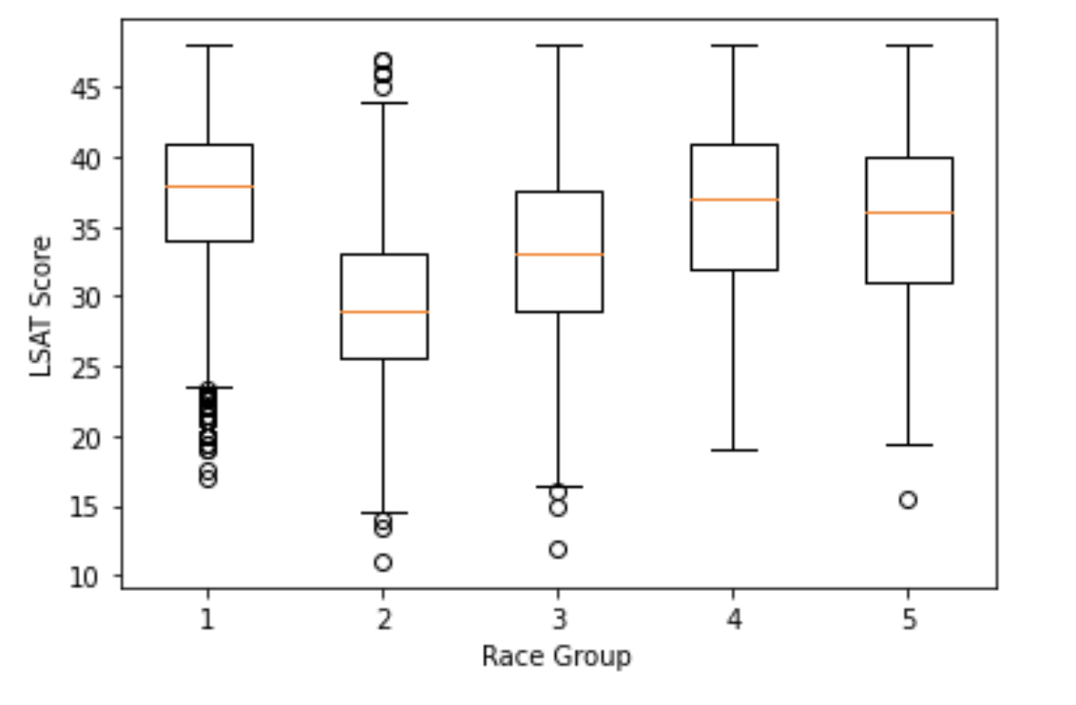
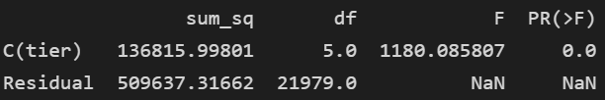


Boxplot & ANOVA for LSAT score
School Tier
Race
Family Income

Slide 14
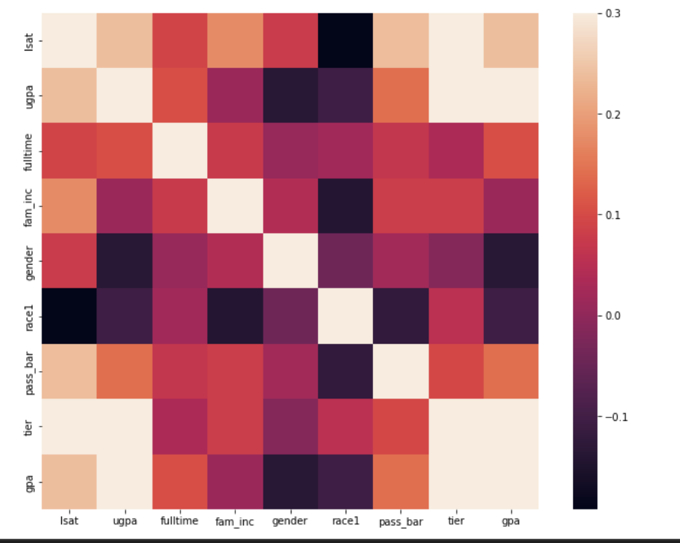
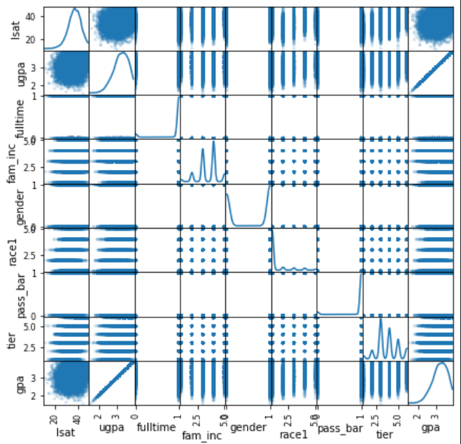
Correlation Matrix

Slide 15
SMART Question 1
What contributions affect the LSAT score significantly?
School Tier?
Undergraduate GPA?

Slide 16

Prediction 1: Linear Regression

Slide 17
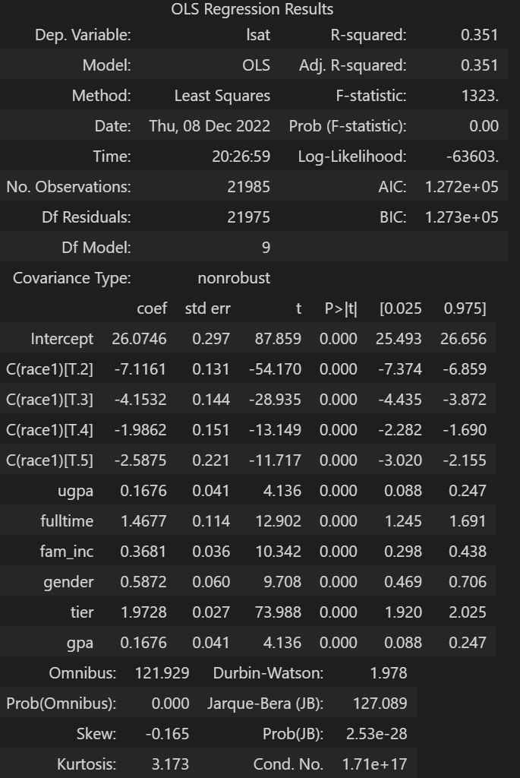
Statistical Analysis for Q1
Race, Gender, Undergraduate GPA, Family Income, University Tier, Law school GPA are statistically related to LSAT score.
Higher tier school, Higher LSAT score
Higher Undergraduate GPA, Higher LSAT score

Slide 18
LM with sklearn
Ready for using sklearn (LinearRegression)
Split the dataset into Train (80%, 17588) & Test (20%, 4397)
Sklearn Result
Train score: 0.277
Test score: 0.287
Cross Validation for Linear Regression Model (CV = 5)
Results Mean : 0.273

Slide 19

Prediction 2: Decision Tree Regression

Slide 20
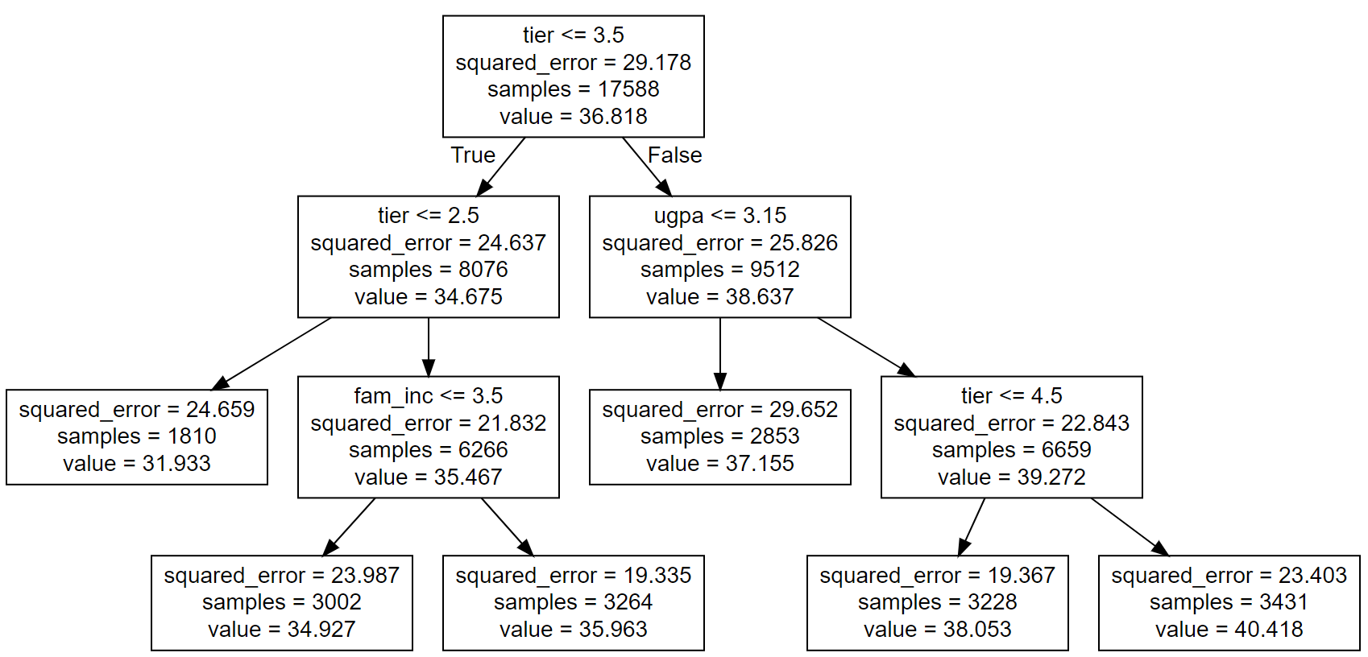
Decision Tree Graph

Slide 21

Prediction 3: Principal Component Regression

Slide 22
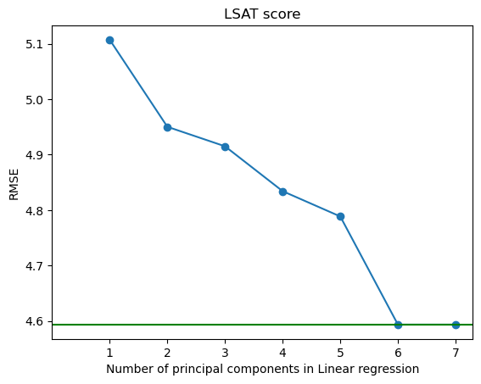
PCR
First, we scaled the data to fit in the PCR model.
Then, from the visual representation of the PCR values, we found out that we can reduce the computation and achieve the same results by only using the first six variables.
The RMSE was reduced to 4.648 (using Linear Regression).

Slide 23
Results of Models for Q1
Model | Result
Linear Regression model | Score 0.28 ~ 28%
Decision Tree Regressor | RMSE of 4.84
PCR with Linear Regression | RMSE of 4.648

Slide 24
SMART Question 2
What contributions significantly affect clearing the bar exam?
School Tier
Law school GPA
Undergraduate GPA
LSAT score
Family Income
Full time student
Race
Gender

Slide 25
Classification 1: Logit Regression

Slide 26
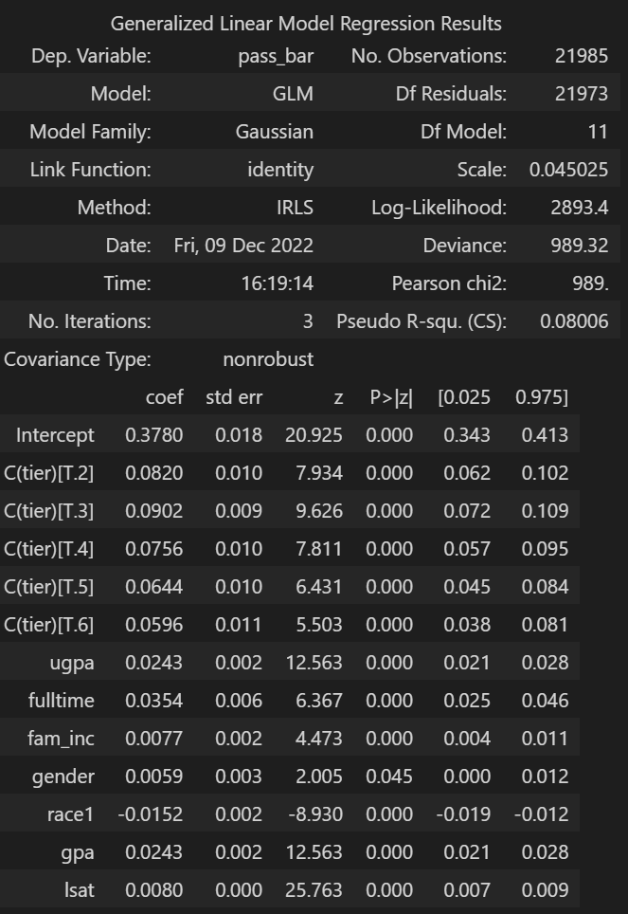
Statistical Analysis for Q2
Higher Undergraduate GPA
Higher LSAT score
Higher School Tier
Higher Law school GPA
Higher Family Income
Male, Full time Student
Higher chance to pass the bar exam

Slide 27
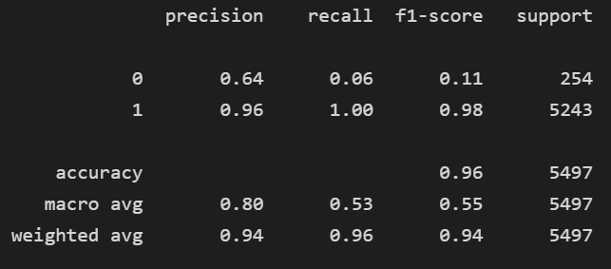
Logit with sklearn
Ready for using sklearn (LogisticRegression)
Split the dataset into Train (80%, 16488) & Test (20%, 5497)
Sklearn Result
Logit model accuracy with the test set: 0.955
Logit model accuracy with the train set: 0.947
Classification Report

Slide 28
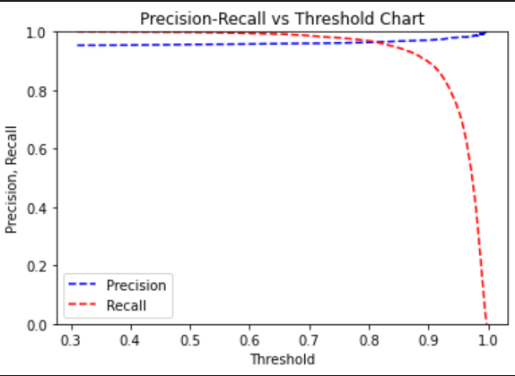
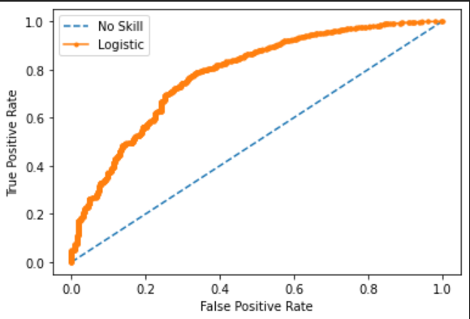
Logit with sklearn
AUC: 0.781
AUC is an aggregated metric evaluating how well a logistic regression model classifies positive and negative outcomes at all possible cutoffs. AUC also means for evaluating predictive performance of a model.
The higher threshold, the higher the precision, but the lower the recall: the deal threshold setting is the highest possible recall and precision rate. Our threshold is 0.8.

Slide 29

Classification 2: KNN

Slide 30
KNN with Cross validation
K = 7 and CV folds = 10 Accuracy Mean Result : 0.946
Ready for using sklearn (KNeighborsClassifier)
Split the dataset into Train (80%) & Test (20%)

Slide 31
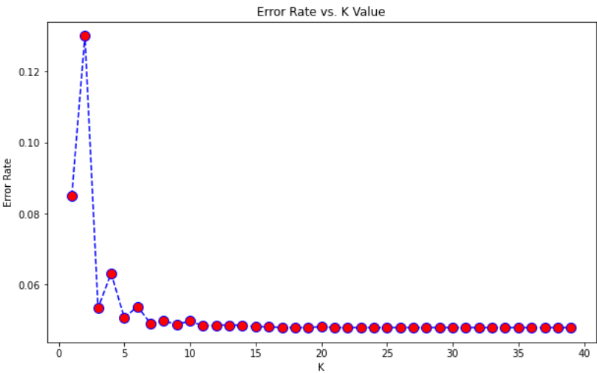
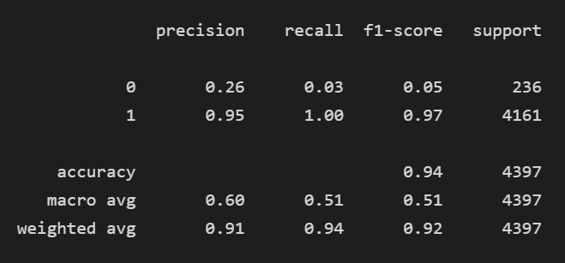
KNN with sklearn
Confusion Matrix (K = 7) | Actual 0 | Actual 1
Prediction 0 | 6 | 230
Prediction 1 | 17 | 4144

Slide 32
Results of Models for Q2
Model | Result
Logit Regression | Score 95%
KNN | k = 7, Score 94%

Slide 33
Summary
Undergraduate GPA, School Tier, Law school GPA, and Family Income are positively related to LSAT scores.
Higher tier school, Higher LSAT score
Higher Undergraduate GPA, Higher LSAT score
Higher Law school GPA, Undergraduate GPA, LSAT score, and School Tier increase the chance to pass the bar exam.
Higher Law school GPA, Higher chance to pass the bar exam
Demographic differences were found in different gender and race groups.
e.g. Full time, Male, Higher Family Income group shows better performance in LSAT & Bar pass.

Slide 34
Fun Fact: K-Means
K-means groups similar data points together and discovers underlying patterns.
K-means looks for a fixed number (k) of clusters in a dataset.
A cluster refers to a collection of data points aggregated together because of certain similarities.

Slide 35
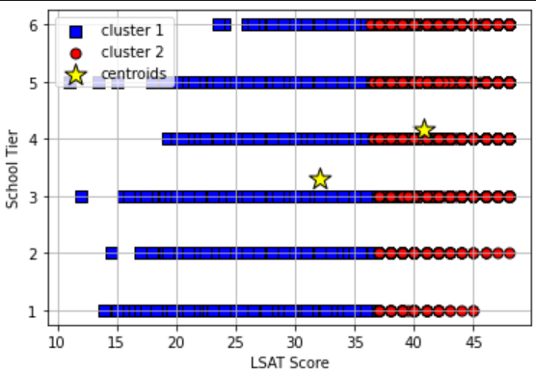
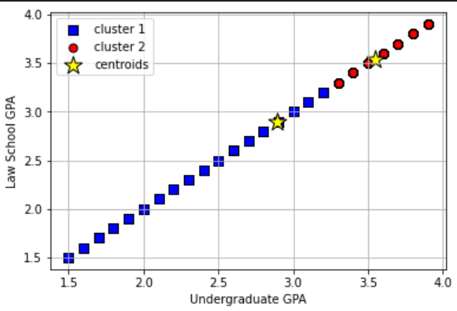
KMeans

Slide 36
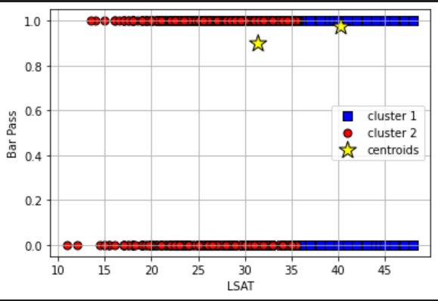
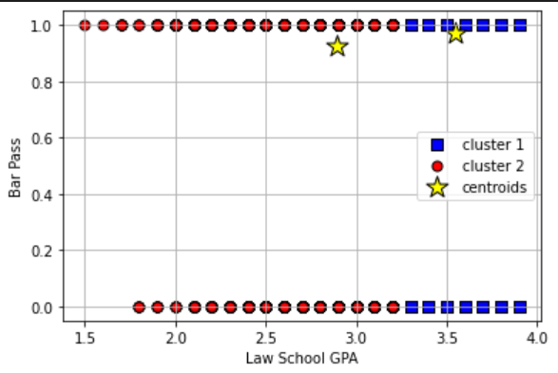
KMeans

Slide 37

Questions?

Slide 38


Thank you & Happy Holidays!

